Slide 1

Next-Word Prediction
Supervised project work
Project work by: Krishna G Bhat
Mentors:
Nilesh Bhagwandas Chopda
Mounesh gouda

Slide 2
WEEK-1
BUSINESS UNDERSTANDING :
Next-Word prediction is a computer program which is used to predict the next word that a user is likely to type in a given sentence.
Next-word prediction is valuable tool for businesses, as it can help improve the user experiences, reduce the amount of time spent typing, and increases the accuracy in natural language processing. Additionally, it can also be used to improve customer service through chatbots and virtual assistants, By incorporating this technology into clients application and services, Businesses can gain a competitive edge and provide their users with a better overall experience.

Slide 3
Data Preparation steps:
Data Collection
Data Splitting
Vocabulary Creation
Text preprocessing
Data Cleaning
Text representation

Slide 4
Approach to data preparation:
Data collection: The first step in data preparation is to collect a corpus of text data. This can be done by scraping websites, downloading pre-existing datasets, or using APIs to access textual data. The corpus should be representative of the language and domain that you are interested in modeling.
Text preprocessing: Once you have collected the corpus, the next step is to preprocess the text data. This involves several steps, such as
- removing punctuation
- converting all text to lowercase
- tokenizing the text into words or phrases
- removing stop words (e.g., "the", "and")
- stemming or lemmatizing the text to reduce inflectional forms to their base form.

Slide 5
Data cleaning: After text preprocessing, it is important to clean the data to remove irrelevant or noisy information that can negatively impact the model's performance. This can involve removing duplicates, correcting misspellings, removing non-textual characters or symbols, and removing URLs or other non-textual information.
Data splitting: Once the data has been cleaned and preprocessed, it needs to be split into training, validation, and testing sets. The training set is used to train the language model, the validation set is used to tune hyper parameters and evaluate the model's performance during training, and the testing set is used to evaluate the final model's performance on unseen data.
Vocabulary creation: Next, a vocabulary needs to be created from the preprocessed text data. The vocabulary consists of all the unique words or phrases that appear in the corpus. Each word or phrase is assigned a unique integer index, which is used to represent it numerically in the model.
Text representation: Finally, the preprocessed text data needs to be represented numerically in a format that can be used for modeling. This can be done using various techniques, such as bag-of-words, n-gram, or word embedding models, which convert the text data into a matrix of numerical values that can be used as input to the language model.

Slide 6
Models:
Bag of words(BoW)
N-grams
RNN

Slide 7
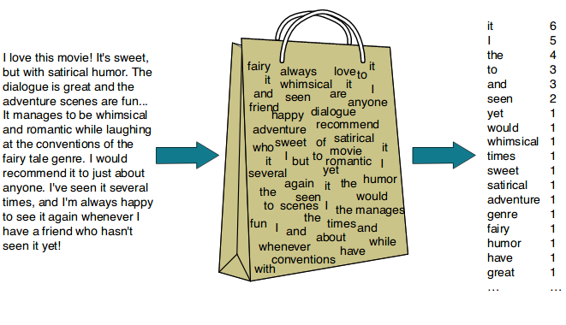
Models:
There are many different models that can be used for natural language processing (NLP) projects, depending on the specific task and the data available. Here are some of the most common models used in NLP:
Bag-of-Words (BoW) : BoW is a simple model that represents text as a bag of its constituent words, ignoring word order and grammar. BoW is often used for tasks such as text classification and sentiment analysis.

Slide 8
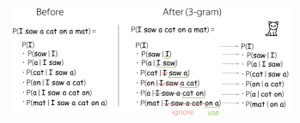
n-gram models : n-gram models are a type of language model that predict the probability of the next word in a sentence based on the previous n words. These models can be used for tasks such as language modeling and text generation.
More formally, the conditional probability of a word W_n given the previous N-1 words in the sequence W_1, W_2, ..., W_n-1 is given by:
P(W_n | W_1, W_2, ..., W_n-1) = count(W_1, W_2, ..., W_n) / count(W_1, W_2, ..., W_n-1)
where count(W_1, W_2, ..., W_n),
represents the number of times the sequence of words W_1, W_2, ..., W_n appears in the training data
count(W_1, W_2, ..., W_n-1),
represents the number of times the sequence of words W_1, W_2, ..., W_n-1 appears in the training data.

Slide 9
For example, suppose we want to predict the next word in the sentence
"I am going to the ___". We can use a trigram model (N=3) to calculate the conditional probability of each possible next word, given the previous two words:
P(W | "to the") = count("to the", W) / count("to the")
We can then choose the word with the highest probability as our predicted next word.
Limitation
One limitation of N-gram models is that they can only consider a fixed number of previous words when making a prediction. This means that they may not capture longer-range dependencies in the language, such as those that occur over multiple sentences or paragraphs. However, N-gram models can still be effective for many language modeling tasks

Slide 10
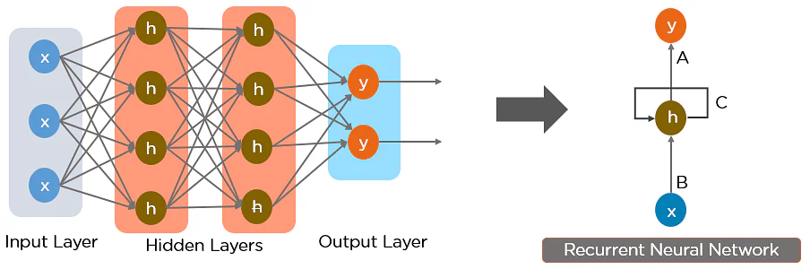
Recurrent Neural Networks (RNNs): RNNs are a type of neural network that can process sequences of data, such as text. RNNs use feedback loops to allow information to persist over time, making them well-suited for tasks such as language modeling, machine translation, and sentiment analysis.
An RNN can be thought of as a series of connected neurons, where each neuron takes as input the output of the previous neuron in the sequence, as well as some external input. The output of each neuron is then passed on to the next neuron in the sequence.
Mathematically, this can be represented as follows:
h_t = f(W_h * h_t-1 + W_x * x_t + b)
where:
h_t is the hidden state of the network at time step t. It contains information about the current input x_t, as well as the previous inputs x_t-1, x_t-2, ..., x_1.

Slide 11
where:
h_t is the hidden state of the network at time step t. It contains information about the current input
x_t, as well as the previous inputs x_t-1, x_t-2, ..., x_1.
x_t is the input at time step t. It could be a vector representing a word in a sentence, a time-series data point, or any other type of input.
W_h and W_x are weight matrices that define the feedback and input connections, respectively. These weights are learned during training to optimize the performance of the network.
b is a bias vector that is added to the weighted sum of inputs and hidden states.
f() is a nonlinear activation function, such as the sigmoid or hyperbolic tangent function, that introduces nonlinearity into the network.

Slide 12
The key idea behind the RNN is that the hidden state at each time step captures information about the current input as well as the previous inputs in the sequence. This allows the network to maintain a "memory" of past inputs, which can be used to make better predictions about future inputs.
Limitation
One limitation of standard RNNs is that they can suffer from the "vanishing gradient" problem, where the gradients used for backpropagation become very small or zero, making it difficult to train the network effectively. To address this problem, several variants of RNNs have been proposed, including Long Short-Term Memory (LSTM) and Gated Recurrent Unit (GRU) networks, which use more complex gating mechanisms to control the flow of information through the network.

Slide 13
List of tools for model and deployment:
Python IDE
NLTK(Natural language Took Kit)
Scikit-learn
Keras
Flask
HTML
Heroku

